Slide 1
Entity Resolution
Student: Tae Hyon Lee
Instructor: Professor David Guy Brizan

Slide 2
Problem: Entity Resolution
There are different ways of addressing a person’s name. Ex: Donald Trump can be mentioned as Donald, Trump, Donald J. Trump, Donald John Trump
For all of the names mentioned in an article, which entities are they referring to?
What can you do to differentiate and identify ambiguous names such as Donald without context?

Slide 3
Data
names
entities
id | name
1 | “Donald”
2 | “Trump”
3 | “Donald J. Trump”
4 | “Robert S. Mueller”
id | name
1 | "Donald Trump"
2 | "Robert Mueller"
3 | "Michael Cohen"
4 | "Chris Wallace"
match
names_id | entity_id
1 | 1
2 | 1
3 | 1
4 | 2
Source:
quantum production db

Slide 4
Transformation
Remove all non-alphabet including space
Capitalize every character
names
entities
id | name
1 | DONALD
2 | TRUMP
3 | DONALDJTRUMP
4 | ROBERTSMUELLER
id | name
1 | DONALDTRUMP
2 | ROBERTMUELLER
3 | MICHAELCOHEN
4 | CHRISWALLACE

Slide 5
Features
Perfect Match
Levenshtein
Affine Gap Distance
SequenceMatcher - Similarities
SequenceMatcher - Length of the most common string

Slide 6
Train set creation
For every name, match with every entity
name | entity_name | the 5 features... | actual
DONALD | DONALDTRUMP | … | 1
DONALD | ROBERTMUELLER | … | 0
DONALD | MICHAELCOHEN | … | 0
DONALD | CHRISWALLACE | … | 0

Slide 7
Train/Test set size
Train set size: 75 unique names
Test set size: 54 unique names
Entities: 73 unique entities
Each name has at least one match to entity
Manually picked out test set to test similar names. Ex: Hillary Clinton, Bill Clinton, Mike Pence, Mike Pompeo

Slide 8
Model Creation
GridSearchCV with Random Forest Classifier and StratifiedKFold
Returns a prediction probability for each input

Slide 9
Output
Threshold = 0.4
name | entity_name | predict_prob | y_predicted | y_actual
CLINTON | HILLARYCLINTON | 0.8 | 1 | 1
CLINTON | BILLCLINTON | 0.8 | 1 | 0
CLINTON | DONALDTRUMP | 0.0 | 0 | 0
MIKEPENCE | MIKEPOMPEO | 0.7 | 1 | 0

Slide 10
Performance Metric: Accuracy, Precision, Recall, F1
Accuracy: Not suitable
Precision: Out of all predicted matches, how many were actual matches
Recall: Out of all the actual matches, how many were predicted?
F1: Average of precision and recall

Slide 11
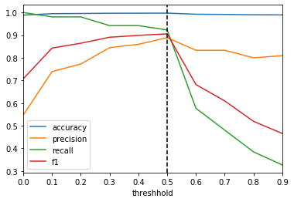
Metric vs Threshold

Slide 12
Problem
Hard to identify entity for names such as “Clinton”
Is it Bill Clinton? Or is it Hillary Clinton
name | entity_name | predict_prob | y_predicted | y_actual
CLINTON | HILLARYCLINTON | 0.8 | 1 | 1
CLINTON | BILLCLINTON | 0.8 | 1 | 0

Slide 13
Idea
For all names, search through the other names mentioned in the article and choose the name that is mentioned the most and contains the name and label it as “aka”
Ex. name: “Clinton”, aka: “Hillary Clinton”
Can be done through SQL queries on the database

Slide 14
Updated dataset
names
id | name | aka
1 | Donald | Donald Trump
2 | Clinton | Hillary Clinton
3 | Mike | Mike Pence
4 | Robert | Robert Mueller
5 | Bob | (Robert Muller)*
* Not tested but possible problem with using the query

Slide 15
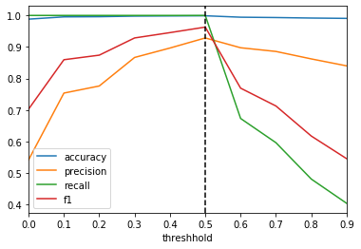
Metric vs Threshold

Slide 16
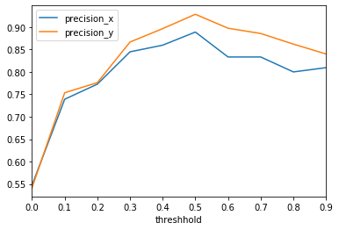
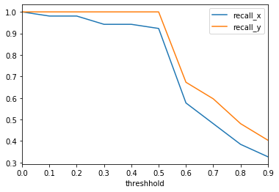
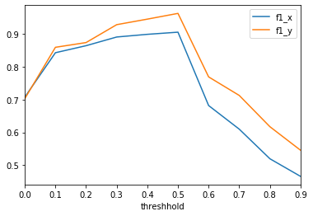
Comparison

Slide 17
Hmm… wait
We have prediction prob…
Why not just choose the highest probability for each name?
We know that for each name, there is at least one actual match that has a probability > 0 (Recall = 1 at threshold > 0)

Slide 18
Steps
Use matches found from threshold > 0
Group by name and choose the entity name with the highest probability

Slide 19
Outcome
Recall: 1
Precision: 0.9555555555555556
Hooray...?

Slide 20
Existing Problem
name | entity_name | predict_prob | predicted | actual
MIKEPENCE | MIKEPOMPEO | 1.0 | 1 | 0
MIKEPENCE | MIKEPENCE | 1,0 | 1 | 1

Slide 21
Possible Solutions
Add more data…
Add relevant features such as context or other information available in the article

